Slide 1
DMAS: Decentralized Multiagent Simulation – System Architecture
Alan Aguilar Jaramillo, Ben Gorr, Chrissi Erwin, Dr Daniel Selva Valero

Slide 2
Chlorophyll Test Case Progress
Flow of data through system:
Agent sends an “Observation Sense” message to the environment
Environment responds with the “radiances” (image file for now)
Agent passes the “radiances” to the science module
Science module processes the “radiances” into a chlorophyll mask
The generated chlorophyll mask is compared to stored historical chlorophyll data
The current chlorophyll is >1σ above the mean, a measurement request is generated and sent to the planning module
The planning module sees that the requested measurement is “chlorophyll” and checks the knowledge graph to see if its instrument is capable of observing “chlorophyll”
The capability is confirmed and sent to the MCBBA algorithm

Slide 3
Chl example
Agent
Simulation Module
Science Module
Event Handler
-Simulation Events
Sim Start/End
On-board Processor
-Processed data
Science “reasoning”
-Environment Events
-Simulation Events
SUB
-Model req/results
-Environment Events
Environment
Science data-base
-Past data
Science Predictive Models
-Measurement Data (from self or in)
-Information Request
-Events of interest
REQ
-Proposed Measurement Requests
-Proposed Information
Requests
-Mission Requirements
-Past measurement data
-Model req/results
-GP access req
-GS access req
-Agent access req
-Agent state req
-Observation sense req
Science Value Model
-Measurement Requests
-Information Request
-Measurement Request
-Information Request
-Measurement Results
-Planner Results
Engineering Module
REQ
Other Agents
-Agent State
-Planner Results (in)
-Measurement Requests (in)
REP
Scheduler Module
-Measurement Request
-Information Request
-Measurement Results
-Planner Results
-Tasks (for self or out)
-Measurement Requests (out)
-Information Requests (out)
-Measurement Results (out)
-Planner Results (out)

Slide 4

Chl example step 1
Agent
Simulation Module
Science Module
Event Handler
-Simulation Events
Sim Start/End
On-board Processor
-Processed data
Science “reasoning”
-Environment Events
-Simulation Events
SUB
-Model req/results
-Environment Events
Environment
Science data-base
-Past data
Science Predictive Models
-Measurement Data (from self or in)
-Information Request
-Events of interest
REQ
To environment: “I’m looking at 69.927 deg lat, -112.3 deg lon. What is the camera seeing on the Earth’s surface?”
-Proposed Measurement Requests
-Proposed Information
Requests
-Model req/results
-GP access req
-GS access req
-Agent access req
-Agent state req
-Observation sense req
-Mission Requirements
-Past measurement data
Science Value Model
-Measurement Requests
-Information Request
-Measurement Request
-Information Request
-Measurement Results
-Planner Results
Engineering Module
REQ
Other Agents
-Agent State
-Planner Results (in)
-Measurement Requests (in)
REP
Scheduler Module
-Measurement Request
-Information Request
-Measurement Results
-Planner Results
-Tasks (for self or out)
-Measurement Requests (out)
-Information Requests (out)
-Measurement Results (out)
-Planner Results (out)

Slide 5
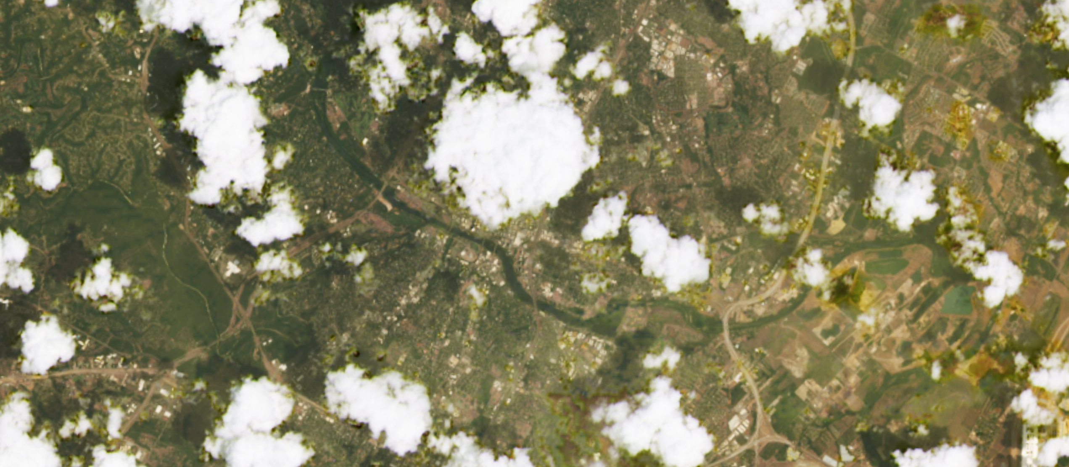
Chl example step 2
Agent
Simulation Module
Science Module
Event Handler
-Simulation Events
Sim Start/End
On-board Processor
-Processed data
Science “reasoning”
-Environment Events
-Simulation Events
SUB
-Model req/results
-Environment Events
Environment
Science data-base
-Past data
Science Predictive Models
-Measurement Data (from self or in)
-Information Request
-Events of interest
REQ
To environment: “I’m looking at 69.927 deg lat, -112.3 deg lat. What is the camera seeing on the Earth’s surface?”
-Proposed Measurement Requests
-Proposed Information
Requests
-Model req/results
-GP access req
-GS access req
-Agent access req
-Agent state req
-Observation sense req
-Mission Requirements
-Past measurement data
Science Value Model
-Measurement Requests
-Information Request
-Measurement Request
-Information Request
-Measurement Results
-Planner Results
Engineering Module
REQ
Other Agents
-Agent State
-Planner Results (in)
-Measurement Requests (in)
REP
Scheduler Module
-Measurement Request
-Information Request
-Measurement Results
-Planner Results
-Tasks (for self or out)
-Measurement Requests (out)
-Information Requests (out)
-Measurement Results (out)
-Planner Results (out)

Slide 6
Chl example step 3
Agent
Simulation Module
Science Module
Event Handler
-Simulation Events
Sim Start/End
On-board Processor
-Processed data
Science “reasoning”
-Environment Events
-Simulation Events
SUB
-Model req/results
-Environment Events
Environment
Science data-base
-Past data
Science Predictive Models
-Measurement Data (from self or in)
-Information Request
-Events of interest
REQ
*Note that in the future, the camera in the engineering module will add noise/filtering/reality
-Proposed Measurement Requests
-Proposed Information
Requests
-Mission Requirements
-Past measurement data
-Model req/results
-GP access req
-GS access req
-Agent access req
-Agent state req
-Observation sense req
Science Value Model
-Measurement Requests
-Information Request
-Measurement Request
-Information Request
-Measurement Results
-Planner Results
Engineering Module
REQ
Other Agents
-Agent State
-Planner Results (in)
-Measurement Requests (in)
REP
Scheduler Module
-Measurement Request
-Information Request
-Measurement Results
-Planner Results
-Tasks (for self or out)
-Measurement Requests (out)
-Information Requests (out)
-Measurement Results (out)
-Planner Results (out)

Slide 7
Chl example step 4
Agent
Simulation Module
Science Module
Event Handler
-Simulation Events
Sim Start/End
On-board Processor
-Processed data
Science “reasoning”
-Environment Events
-Simulation Events
SUB
-Model req/results
-Environment Events
Environment
Science data-base
-Past data
Science Predictive Models
-Measurement Data (from self or in)
-Information Request
Chla_outputdata.csv: “…,165.04705882352943,169.04597701149424,174.01136363636363,178.01111111111112,182.01086956521738,185.98924731182797,186.97849462365593,189.9894736842105,189.9894736842105,187.98936170212767,183.96703296703296,178.97752808988764,175.98863636363637,175.0,169.98823529411766...”
-Events of interest
REQ
-Proposed Measurement Requests
-Proposed Information
Requests
-Mission Requirements
-Past measurement data
-Model req/results
-GP access req
-GS access req
-Agent access req
-Agent state req
-Observation sense req
Science Value Model
-Measurement Requests
-Information Request
-Measurement Request
-Information Request
-Measurement Results
-Planner Results
Engineering Module
REQ
Other Agents
-Agent State
-Planner Results (in)
-Measurement Requests (in)
REP
Scheduler Module
-Measurement Request
-Information Request
-Measurement Results
-Planner Results
-Tasks (for self or out)
-Measurement Requests (out)
-Information Requests (out)
-Measurement Results (out)
-Planner Results (out)

Slide 8
Chl example step 5
At 69.929, -112.3036, the mean+stddev is historically 170.1, which is exceeded by the current value of 182. There might be an algal bloom here!
Chl_baseline.csv: lon,lat,mean,sd
-112.3036,69.928615,32516.7883066595,17124.3404118277
-73.3296,44.51466,24035.0911080139,16868.8068734388
88.32758,68.28186,29682.7581931179,18526.6282186161
Agent
Simulation Module
Science Module
Event Handler
-Simulation Events
Sim Start/End
On-board Processor
-Processed data
Science “reasoning”
-Environment Events
-Simulation Events
SUB
-Model req/results
-Environment Events
Environment
Science data-base
-Past data
Science Predictive Models
-Measurement Data (from self or in)
-Information Request
-Events of interest
REQ
-Proposed Measurement Requests
-Proposed Information
Requests
-Mission Requirements
-Past measurement data
-Model req/results
-GP access req
-GS access req
-Agent access req
-Agent state req
-Observation sense req
Science Value Model
Chla_outputdata.csv: “…,165.04705882352943,169.04597701149424,174.01136363636363,178.01111111111112,182.01086956521738,185.98924731182797,186.97849462365593,189.9894736842105,189.9894736842105,187.98936170212767,183.96703296703296,178.97752808988764,175.98863636363637,175.0,169.98823529411766...”
-Measurement Requests
-Information Request
-Measurement Request
-Information Request
-Measurement Results
-Planner Results
Engineering Module
REQ
Other Agents
-Agent State
-Planner Results (in)
-Measurement Requests (in)
REP
Scheduler Module
-Measurement Request
-Information Request
-Measurement Results
-Planner Results
-Tasks (for self or out)
-Measurement Requests (out)
-Information Requests (out)
-Measurement Results (out)
-Planner Results (out)

Slide 9
Chl example step 6
At 69.929, -112.3036, the mean+stddev is historically 170.1, which is exceeded by the current value of 182. There might be an algal bloom here!
Agent
Simulation Module
Science Module
Event Handler
-Simulation Events
Sim Start/End
On-board Processor
-Processed data
Science “reasoning”
-Environment Events
-Simulation Events
SUB
-Model req/results
-Environment Events
Environment
Science data-base
-Past data
Science Predictive Models
-Measurement Data (from self or in)
-Information Request
-Events of interest
REQ
-Proposed Measurement Requests
-Proposed Information
Requests
-Mission Requirements
-Past measurement data
-Model req/results
-GP access req
-GS access req
-Agent access req
-Agent state req
-Observation sense req
Science Value Model
-Measurement Requests
-Information Request
-Measurement Request
-Information Request
-Measurement Results
-Planner Results
Engineering Module
REQ
To the planning module: “There is an event of interest with severity X, please measure it!”
Other Agents
-Agent State
-Planner Results (in)
-Measurement Requests (in)
REP
Scheduler Module
-Measurement Request
-Information Request
-Measurement Results
-Planner Results
-Tasks (for self or out)
-Measurement Requests (out)
-Information Requests (out)
-Measurement Results (out)
-Planner Results (out)

Slide 10
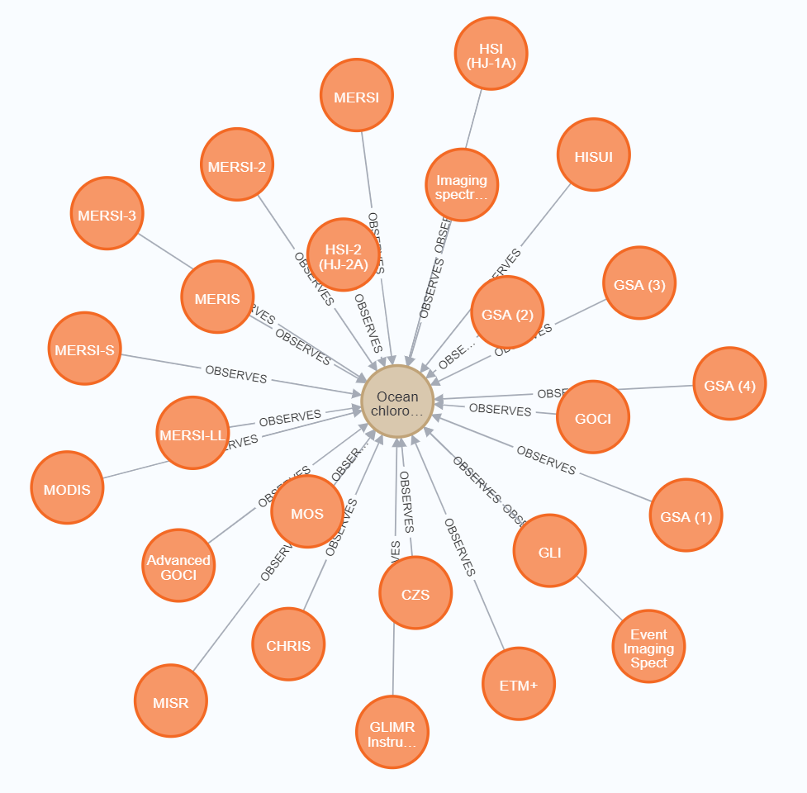
Chl example step 7+8
Agent
Simulation Module
Event Handler
-Simulation Events
Sim Start/End
Science Module
-Environment Events
-Simulation Events
To the planning module: “There is an event of interest with severity X, please measure it!”
SUB
-Environment Events
Environment
REQ
-Measurement Data (from self or in)
-Information Request (in)
-Measurement Data (out)
-GP access req
-GS access req
-Agent access req
-Agent state req
-Measurement observation metrics req
Instrument “OLI” can observe chlorophyll, so this is a good task for the MCBBA
-Measurement Requests (from self)
Scheduler/Planning Module
-Measurement Requests (in)
Knowledge-Base Instrument Capability Reasoning
-Proposed measurements
-Measurement Requests (out)
-Information Requests (out)
-Data Transmission Request (from self)
-Measurement Request
-Information Request
-Measurement Results
-Planner Results
Engineering Module
-Agent State
-Planner Results (in)
-Proposed plan
-Agent state
Observation Planning (Decentralized multiagent-level)
Operations Planning (agent-level)
REQ
-Tasks (for self or out)
-Measurement Requests (out)
-Information Requests (out)
-Measurement Results (out)
-Planner Results (out)
-Modified plan
-Meas. Perf. Score
Other Agents
-Plan
-Agent state
Meas. Perf. Model
-Predicted observation metrics
REP
Predictive Models
-Measurement Request
-Information Request
-Measurement Results
-Planner Results
-Cost Estimate
Cost Model
-Predicted Agent States

Slide 11
Chl example todo
Get server for grabbing images for arbitrary points
Figure out science value
Clean up code

Slide 12
Chlorophyll Test Case Progress
Flow of data through system:
Agent sends an “Observation Sense” message to the environment
Environment responds with the “radiances” (served from Sentinel-2/Landsat)
Agent passes the “radiances” to the science module
Science module processes the “radiances” into a chlorophyll mask
The generated chlorophyll mask is compared to stored historical chlorophyll data
The current chlorophyll is >1σ above the mean, a measurement request is generated by the Science Reasoning module
The Science Value module creates a priority for the measurement request based on the population around the water body from HydroATLAS
The planning module sees that the requested measurement is “chlorophyll” and checks the knowledge graph to see if its instrument is capable of observing “chlorophyll”
The capability is confirmed and sent to the MCBBA algorithm

Slide 13
Chl example
Environment
Agent
Simulation Module
Science Module
Event Handler
-Simulation Events
Sim Start/End
On-board Processor
-Processed data
Science “reasoning”
Image Server – Landsat, Sentinel-2
-Environment Events
-Simulation Events
SUB
-Model req/results
-Environment Events
Images (TIF)
Science data-base
-Past data
Science Predictive Models
Lat, long, altitude OR GeoJSON/shapefiles
-Measurement Data (from self or in)
-Information Request
-Events of interest
REQ
-Proposed Measurement Requests
-Proposed Information
Requests
-Mission Requirements
-Past measurement data
-Model req/results
Simulation Management
-GP access req
-GS access req
-Agent access req
-Agent state req
-Observation sense req
Science Value Model
-Measurement Requests
-Information Request
-Measurement Request
-Information Request
-Measurement Results
-Planner Results
Engineering Module
REQ
Other Agents
-Agent State
-Planner Results (in)
-Measurement Requests (in)
REP
Scheduler Module
-Measurement Request
-Information Request
-Measurement Results
-Planner Results
-Tasks (for self or out)
-Measurement Requests (out)
-Information Requests (out)
-Measurement Results (out)
-Planner Results (out)

Slide 14
Questions?

